Slide 1
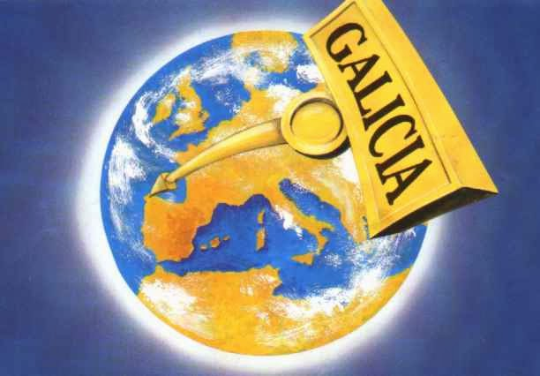

Slide 2
SITUATION PROVINCES AND WEATHER

Slide 3
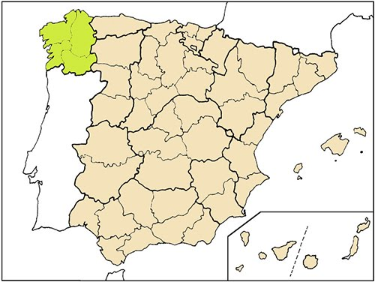
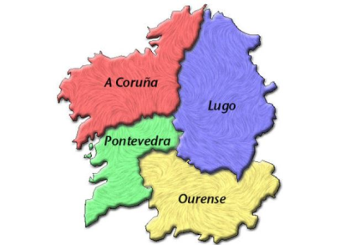
GALICIA
Galicia has 4 provinces: A Coruña, Lugo, Ourense and Pontevedra.
Galicia is in the northWEST of Spain.

Slide 4
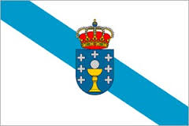
POPULATION
The population is around 2 millions and 7 thousand people.

Slide 5
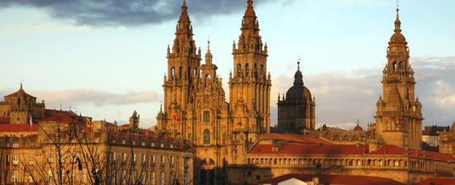
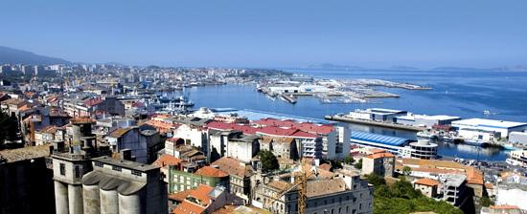
CITY
mjkl nkn
This is Santiago de Compostela
This is Vigo

Slide 6
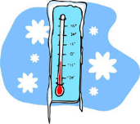
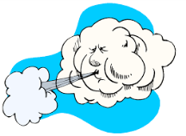
WEATHER IN WINTER AND AUTUMN
RAINY
COLD
WINDY
WEATHER IN SPRING AND SUMMER
SUNNY
HOT

Slide 7
LANGUAGE, FLAG AND MUSIC

Slide 8
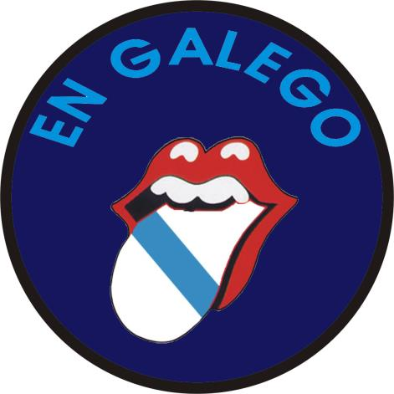
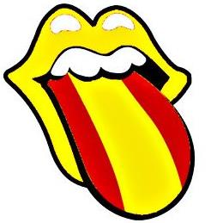
ST
EL
CA
LA
EN
NO
SPANISH LANGUAGE
GALICIAN LANGUAGE

Slide 9
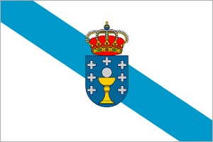
The Galician flag is white with a diagonal blue stripe.

Slide 10
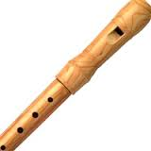
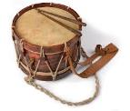
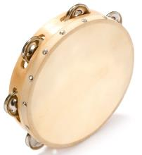
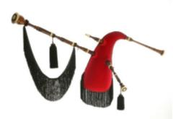
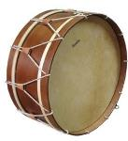
Folk music is the traditional kind of music.
Tambourines, Galician bagpipes, hurdy-gurdies, acoustic guitars, lutes, drums, bass drums, flutes are the typical instruments.
Flauta (flute)
Tambor (drum)
Pandeireta (tambourine)
Gaita galega (Galician bagpipes)
Bombo (bass drum)
Zanfoña (hurdy-gurdy)

Slide 11
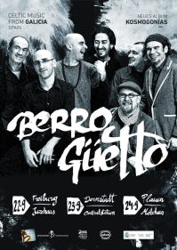
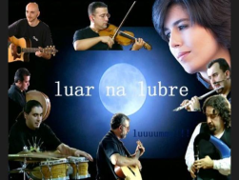
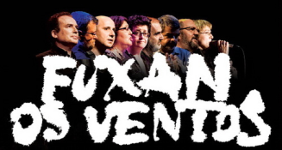
Some famous bands are Milladoiro, Berrogüetto, Luar na Lubre, Fuxan os Ventos, etc.

Slide 12
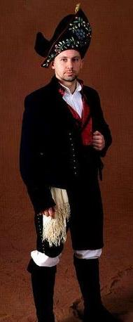
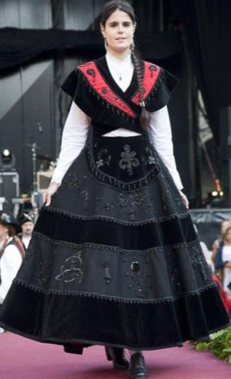
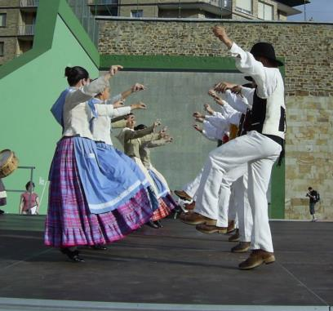
INQUEDANZAS TUI
The most traditional dance and song is “A muiñeira”.

Slide 13
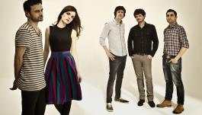
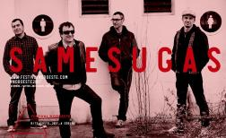
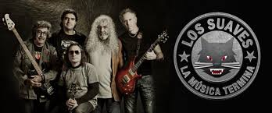
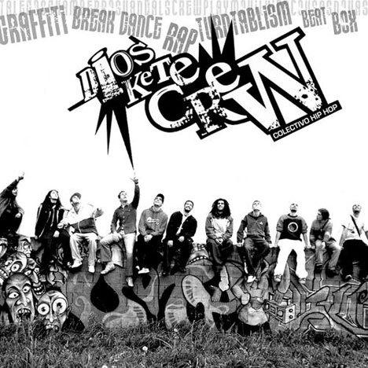
Other bands of different kind of music
Nadadora (pop)
O Grove
Heredeiros da Crus (rock)
Ribeira
Samesugas (punk)
Santiago de Compostela
Los Suaves (heavy rock)
Ourense
Dios ke te crew (hip hop)
Ordes

Slide 14
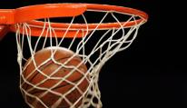
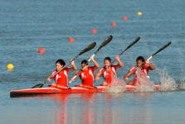
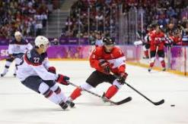
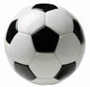
SPORTS

Slide 15
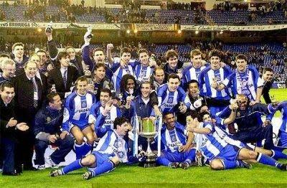
dDD
Celta de Vigo
Deportivo de A Coruña
The king of sports is football. We have two Galician teams in the Spanish Premier League. They are Deportivo de A Coruña and Celta de Vigo. This last played the semifinal of the Europe League this year.

Slide 16
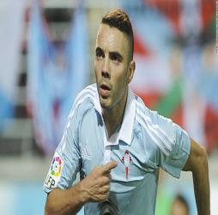
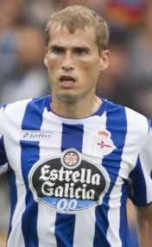
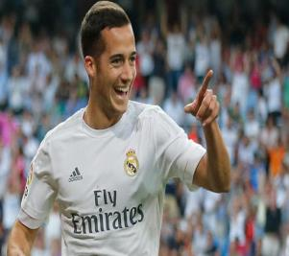
FOOTBALL
The best football players
Iago Aspas
Álex Bergantiños
Lucas Vázquez

Slide 17
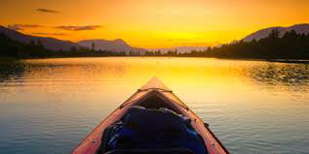
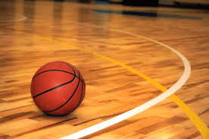
Handball Canoeing
Basketball Roller hockey

Slide 18
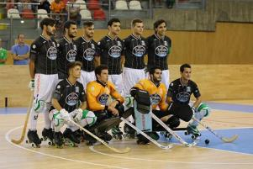
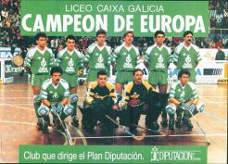
HOCKEY CLUB LICEO
This is the best hockey club of Galicia.

Slide 19
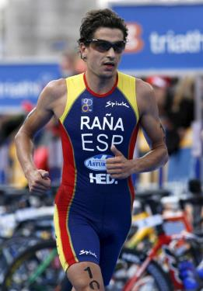
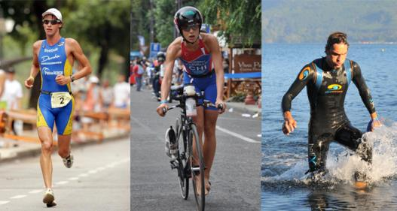
Iván Raña
RUNNING
CYCLING
SWIMMING
Three times triathlon champion of the World.

Slide 20
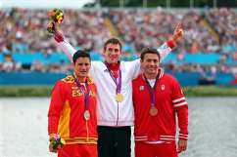
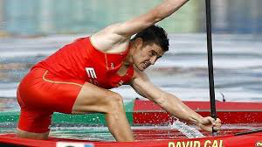
World Champion and Olympic champion of canoeing.
David Cal
champion

Slide 21
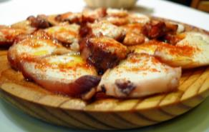
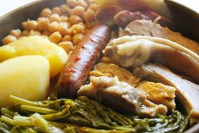
GASTRONOMY

Slide 22
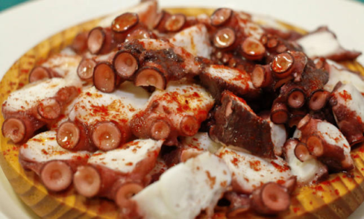
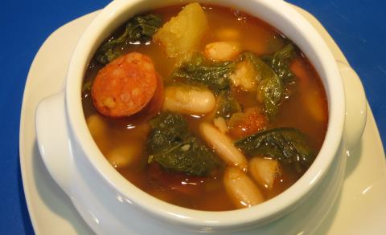
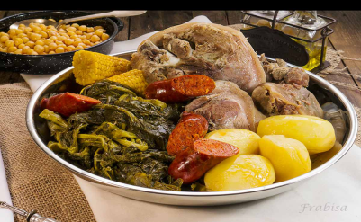
Galician octopus
Galician stew
Turnip greens

Slide 23
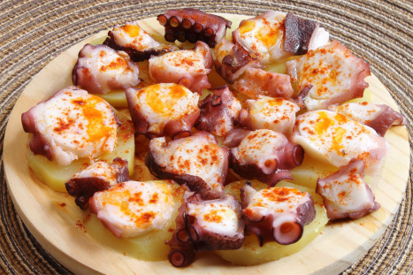
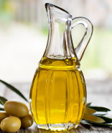
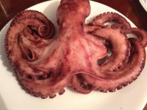
“A feira” style octopus:
Boiled octopus with salt,
olive oil,
served in a flat rounded wooden dish.
paprika,

Slide 24
Galician stew made with potatoes,
cabbage, turnip greens, beans,
chickpeas, carrots and pork.

Slide 25
SHELLFISH
Galician shellfish is the best of Spain.

Slide 26
langoustes,
razor sells, ….
We have best lobsters,
langoustines,
and the most expensive and tastes shellfish is the barnacles.

Slide 27
Ingredients:
Santiago cake

Slide 28
NATURE

Slide 29
FORESTS AND COUNTRYSIDES

Slide 30
FOREST
Os Ancares
O Courel
Oak tree
Pine tree
Chestnut tree
Cork tree

Slide 31
In Galicia you can see diferent species of animals:wild horses,wolves,wild cows etc.

Slide 32
ANIMALS
(THE COAST OF DEATH)
(THE RIVER MIÑO)
IN THE COAST: IN THE RIVERS:
Octopus,turtles,dolphins,sea urchins,sea horses. Trouts,salmons,sardines,eels.
trouts
dolphins
sea urchins
sardines
octopus
salmons
sea horses
eels
turtles

Slide 33
INTERESTING
PLACES
TO
VISIT

Slide 34
INTERESTING PLACES TO VISIT
Province A Coruña
Capital of Galicia (Santiago)

Slide 35
The beautiful cathedral.
Pilgrims
St. James Way
Some of them finsh in Finisterre, one of most occidental point of Europe.

Slide 36
“As Fragas do Eume” Ferrol(A Coruña)

Slide 37
ROMAN WALLS 3RD CENTURY IN LUGO

Slide 38
A RIBEIRA SACRA
A Ribeira Sacra is an amazing place,it grows the best Galician wines.

Slide 39
Amazing “Cies Island”
A lot of reptiles and other kind of animals like cormorants.

Slide 40
THE BEST BEACHES ARE IN PONTEVEDRA

Slide 41
One important beach is “American beach”
It is a beautiful place.

Slide 42
CATHEDRAL BEACH IN RIBADEO

Slide 43
Come and visit Galicia. We are waiting for you!

