Slide 1
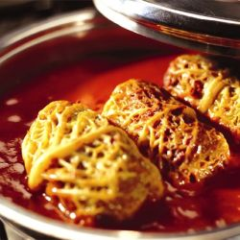
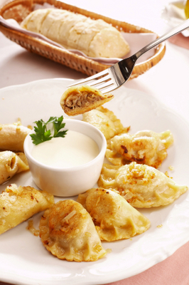
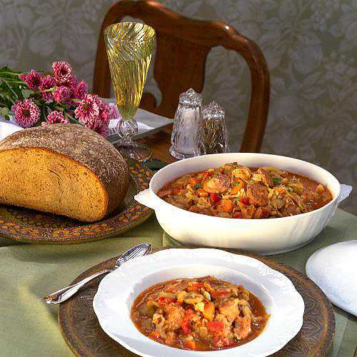
POLISH CUSINE
BIGOS
- brined cabbage with a variety of meats including smoked sausage and a handful of mushrooms
GOŁĄBKI
- Stuffed Cabbage Rolls
PIEROGIES
- Stuffed with potatoes and cottage cheese, serve with cream

Slide 2
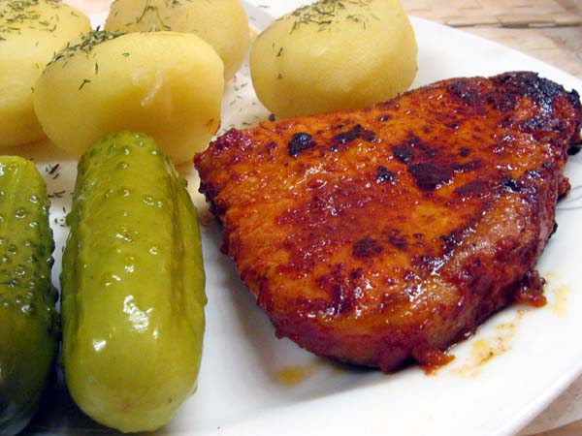
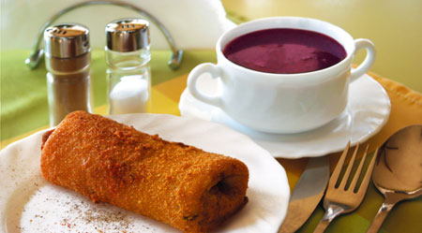
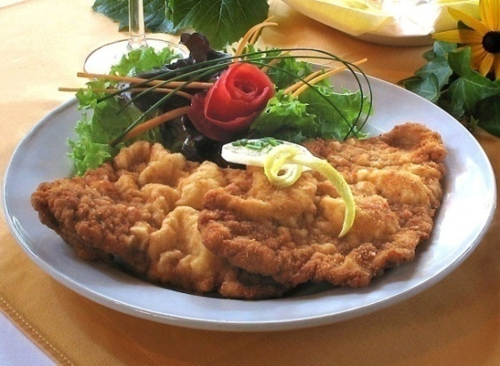
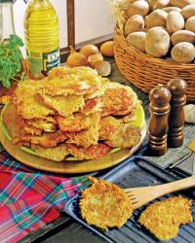
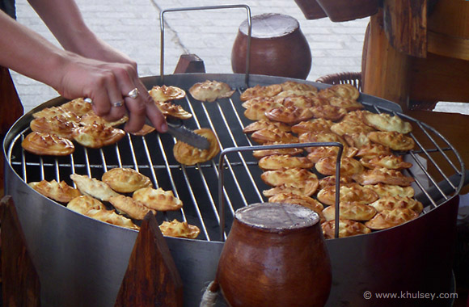
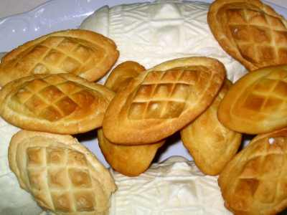
SCHABOWY - Pork Chop
KROKIETY
- Pancakes stuffed with sauerkraut and mushrooms, fried, usually serve with beetroot soup.
Potato pancakes
OSCYPEK
- cooked, smoked cheese

Slide 3
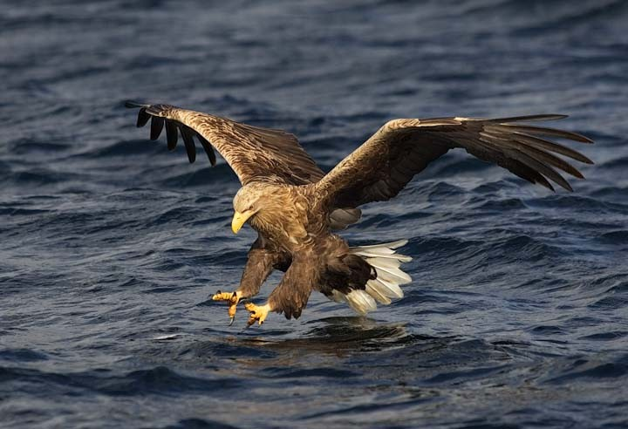
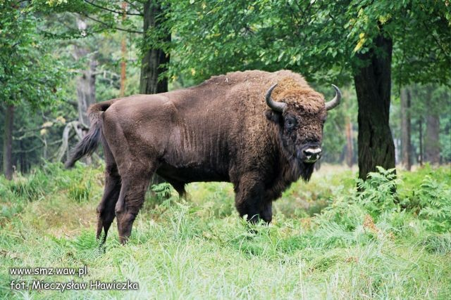
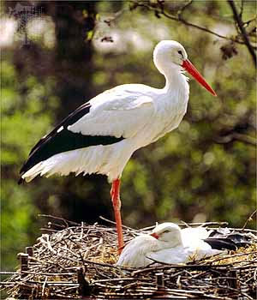
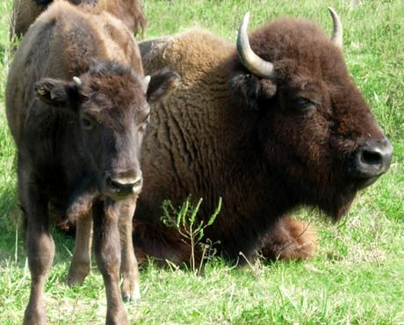
POLISH WILDLIFE
European Bison
White Tailed Eagle
White Stork

Slide 4
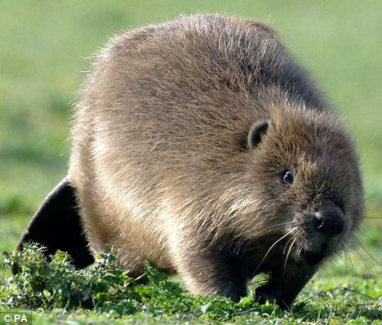
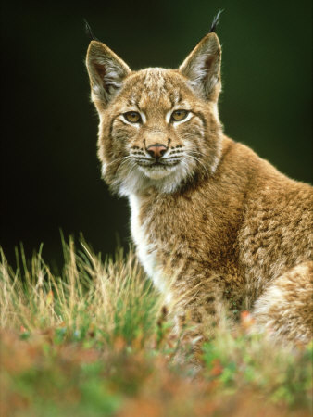
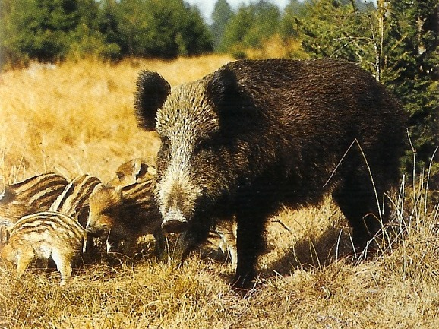
European Beaver
Wild Boar
European Lynx

